Slide 1
Exploring the Functions of Routing

Slide 2
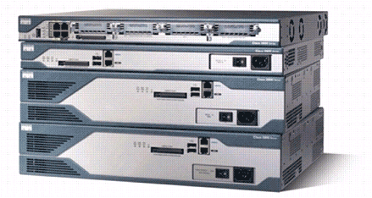
Routers
Cisco 2800 Series Router
  Routers have the following components:
    CPU
    Motherboard
    RAM
    ROM
  Routers have network adapters to which IP addresses are assigned.
  Routers may have the following two kinds of ports:
    Console: For the attachment of a terminal used for management
    Network: Different LAN or WAN media ports
  Routers forward packets based upon a routing table.

Slide 3
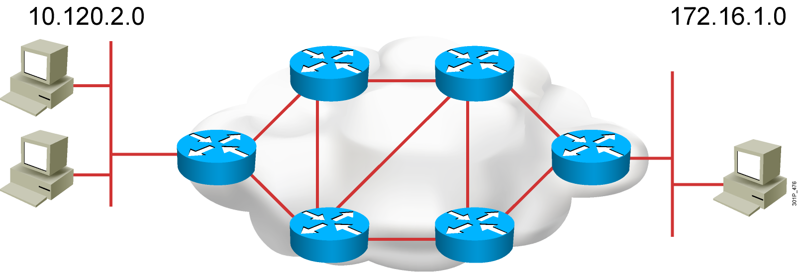
Router Operations
A router needs to do the following:
  Know the destination address.
  Identify the sources from which the router can learn.
  Discover possible routes to the intended destination.
  Select the best route.
  Maintain and verify routing information.
Notes:
Slide 1 of 2
Purpose: This figure introduces students to routing. The router must accomplish the items listed in the figure for routing to occur.
Emphasize: Path determination occurs at Layer 3, the network layer. The path determination function enables a router to evaluate the available paths to a destination and to establish the best path.
Routing services use network topology information when evaluating network paths. This information can be configured by the network administrator (static routes) or collected through dynamic processes (routing protocols) running in the network.
Transition: How do you represent the path to the packet’s destination?

Slide 4
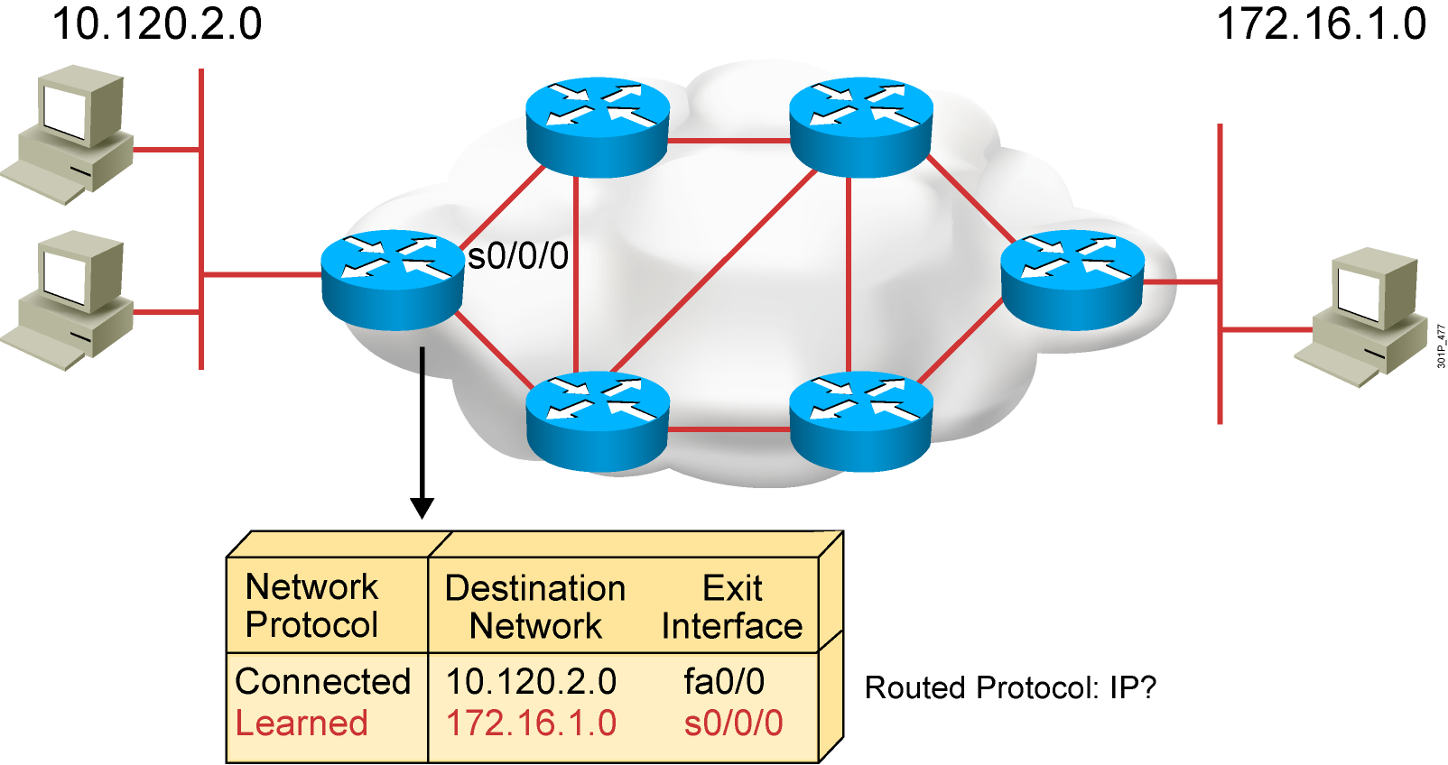
Router Operations (Cont.)
  Routers must learn destinations that are not directly connected.
Notes:
Slide 2 of 2
Purpose: This figure explains that routers must learn about paths that are not directly connected.
Emphasize: The router already knows about directly connected networks. It must learn about those networks that are not connected. This chapter describes how routers learn about those paths.

Slide 5
Router Functions
RouterX# show ip route
D 192.168.1.0/24 [90/25789217] via 10.1.1.1
R 192.168.2.0/24 [120/4] via 10.1.1.2
O 192.168.3.0/24 [110/229840] via 10.1.1.3
1
2
  Lets other routers know about changes
  Determines where to forward packets

Slide 6
Identifying Static and Dynamic Routes
Static route
  Uses a route that a network administrator enters into the router manually
Dynamic route
  Uses a route that a network routing protocol adjusts automatically for topology or traffic changes
Notes:
Purpose: This figure introduces students to static and dynamic routes.
Emphasize: Static knowledge is administered manually—a network administrator enters it into the router’s configuration. The administrator must manually update this static route entry whenever an internetwork topology change requires an update. Static knowledge can be private—by default it is not conveyed to other routers as part of an update process. You can, however, configure the router to share this knowledge.
Dynamic knowledge works differently. After the network administrator enters configuration commands to start dynamic routing, route knowledge is updated automatically by a routing process. Whenever new topology information is received from the internetwork, routers update neighbors about the route change.

Slide 7
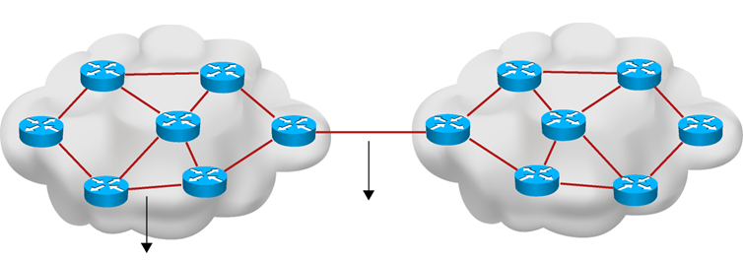


Dynamic Routing Protocols
Autonomous System 10
AS 10
Autonomous System 20
AS 20
IANA
EGP
Exterior Gateway Protocols
BGP
IGP
RIP, EIGRP, OSPF
RIP, EIGRP, OSPF
Interior Gateway Protocols
Distance Vector
Link-state
Hybrid

Slide 8
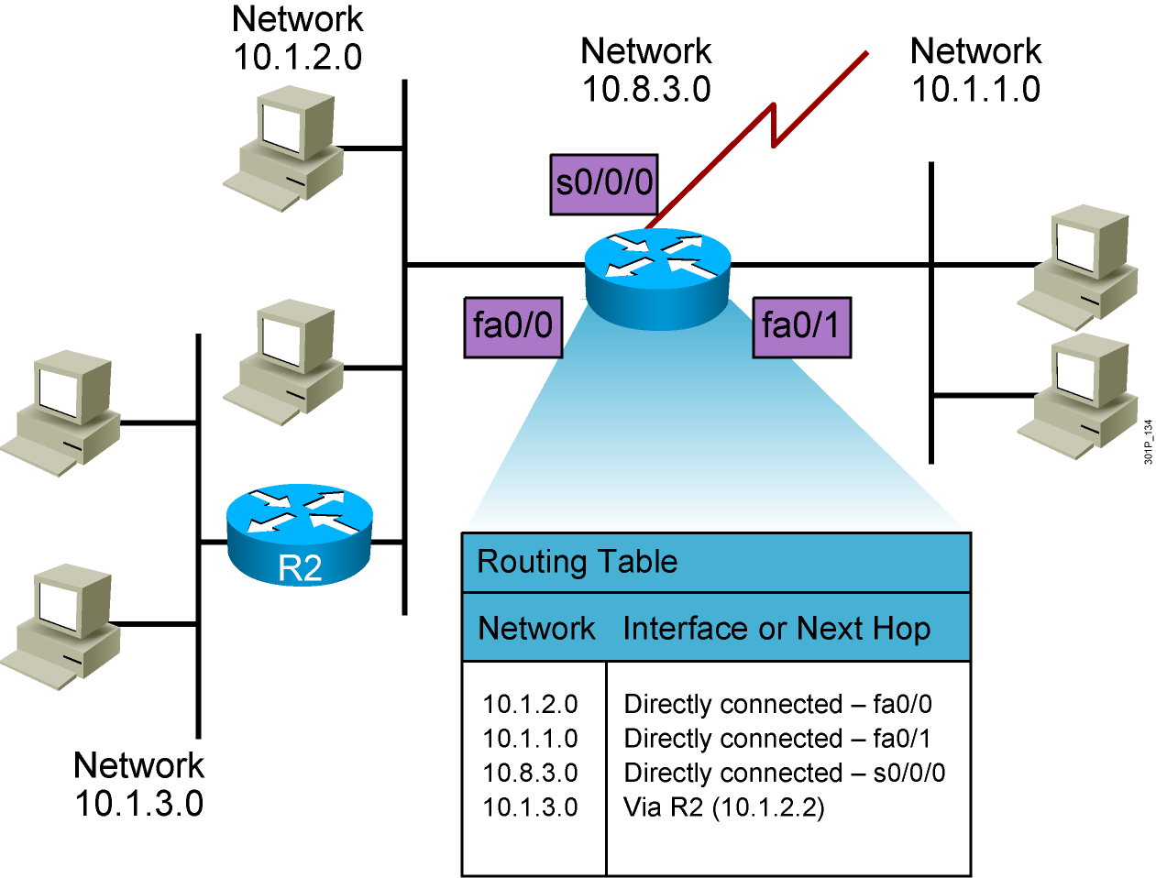
Routing Tables

Slide 9
Routing Table Entries
  Directly connected: Router attaches to this network
  Static routing: Entered manually by a system administrator
  Dynamic routing: Learned by exchange of routing information
  Default route: Statically or dynamically learned; used when no explicit route to network is known

Slide 10
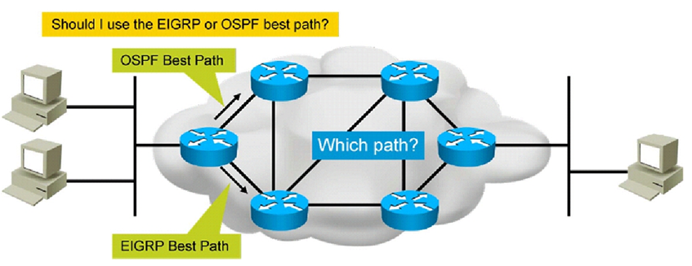
AD - Administrative Distance

Slide 11
AD - Administrative Distance
Protocol | AD Value (0-255)
Connected | 0
Static | 1
EIGRP | 90
OSPF | 110
RIP | 120

Slide 12
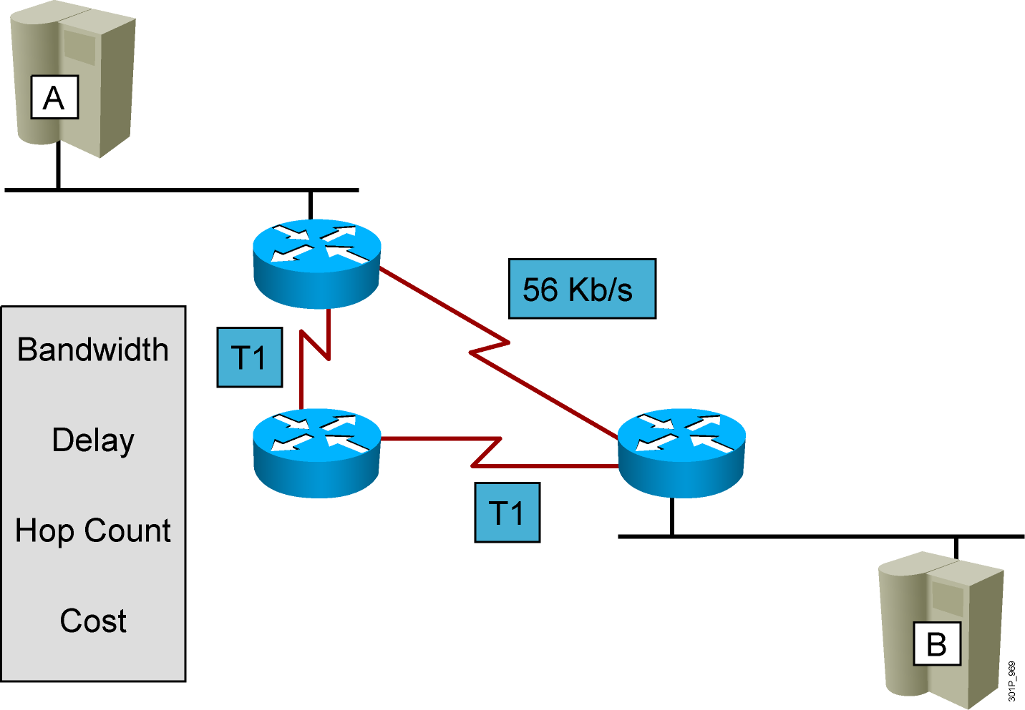
Routing Metrics

Slide 13

Load Balancing
10.0.0.0/8
R1

Slide 14
Enabling Static Routing

Slide 15
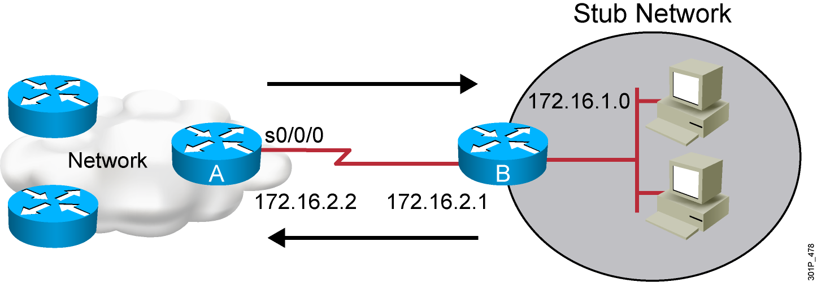
Static Routes
Configure unidirectional static routes to and from a stub network to allow communications to occur.
Notes:
Purpose: This figure describes how a static route operates.
Emphasize: For intercommunication, static routes must be configured in both directions. Static routes are often used to route traffic to a stub network or other network where only a single route to that network exists.

Slide 16
Static Route Configuration
RouterX(config)# ip route network [mask]
{address | interface}[distance] [permanent]
  Defines a path to an IP destination network or subnet or host
  Address = IP address of the next hop router
  Interface = outbound interface of the local router
Notes:
Purpose: This figure describes the command syntax used to establish an IP static route.
Emphasize: A static route allows manual configuration of the routing table. No dynamic changes to this table entry will occur as long as the path is active. Routing updates are not sent on a link that is only defined by a static route; hence, conserving bandwidth.
The ip route field descriptions are as follows:
network—Destination network or subnet
mask—Subnet mask
address—IP address of next-hop router
interface—Name of the interface to use to get to the destination network
Transition: The next figure provides a static route configuration example.

Slide 17
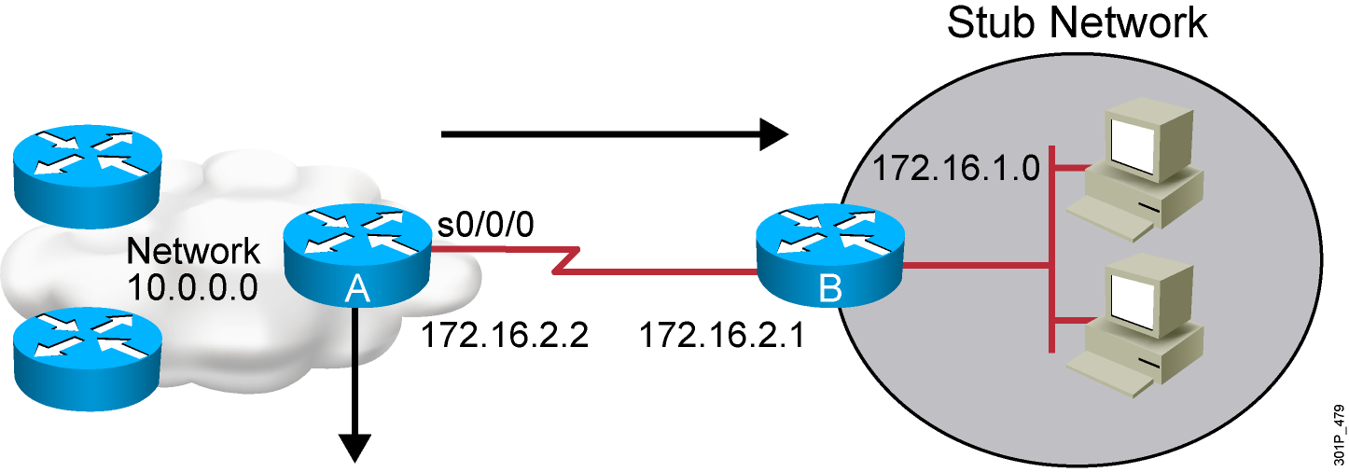
Static Route Example
RouterX(config)#ip route 172.16.1.0 255.255.255.0 172.16.2.1
or
RouterX(config)#ip route 172.16.1.0 255.255.255.0 s0/0/0
  This is a unidirectional route. You must have a route configured in the opposite direction.
Notes:
Purpose: This figure gives an example of a static route configuration.

Slide 18
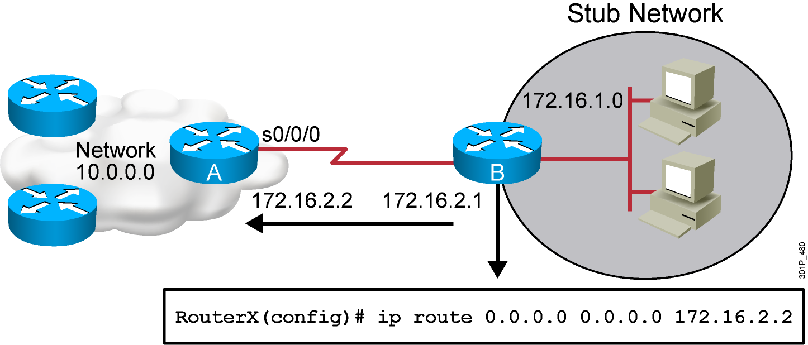
Default Routes
  This route allows the stub network to reach all known networks beyond Router A.
Notes:
Purpose: This figure gives an example of a default route configuration.
Emphasize: With an address and subnet mask of 0.0.0.0 0.0.0.0 in the ip route statement, packets for any network not listed in the routing table will be sent to the next hop, 172.16.2.2.

Slide 19
Verifying the Static
Route Configuration
RouterX# show ip route
Codes: C - connected, S - static, I - IGRP, R - RIP, M - mobile, B - BGP
D - EIGRP, EX - EIGRP external, O - OSPF, IA - OSPF inter area
E1 - OSPF external type 1, E2 - OSPF external type 2, E - EGP
i - IS-IS, L1 - IS-IS level-1, L2 - IS-IS level-2, * - candidate default
U - per-user static route
Gateway of last resort is 0.0.0.0 to network 0.0.0.0
10.0.0.0/8 is subnetted, 1 subnets
C 10.1.1.0 is directly connected, Serial0/0/0
S* 0.0.0.0/0 is directly connected, Serial0
Notes:
Slide 2 of 6
Purpose: This figure shows how the show frame-relay LMI command is used to verify the LMI type used for signaling.
Emphasize: Describe the highlighted output to the students.

Slide 20
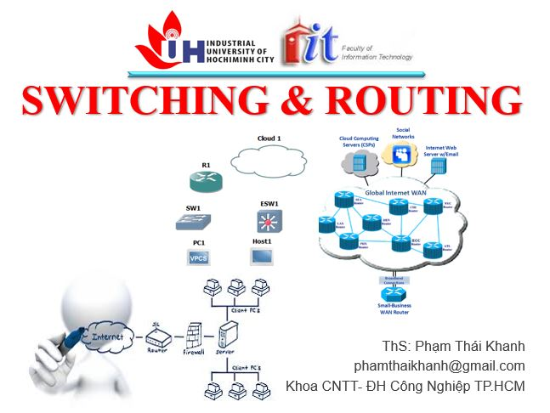



phamthaikhanh@gmail.com
phamthaikhanh@iuh.edu.vn
This Photo by Unknown Author is licensed under CC BY-NC

